Slide 1
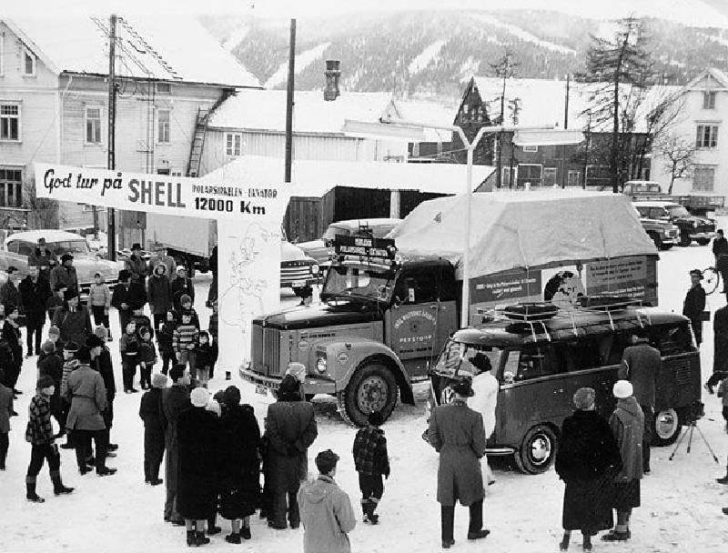
What if the ice block expedition 1959 happens in 2021?
You cannot blame it to climate change
Zhihao LIU
Notes:
1958, Radio Luxembourg launched a challenge, if anyone can ship an ice cubic from arctic to equator without refrigerator, for each kilo they will pay thousands dollor. Sounds like not that smart. To respond this challenges, a group of Norwegians, started the trip, namely the ice block expedition 1959.

Slide 2
The expedition | questions | model | results| discussion
Background
3050 Kg cubic ice from glacier Svartisen
25 cm glasswool and iron container.
on 22 February 1959, at 9:15 am, the expedition left Mo i Rana.
only four litres of water had been shed until Marseille
once the Sahara was traversed, 177 litres had melted away. On average 15 litres melted each day in the desert.
arrived at Libreville on 21 March.
lost only 336 kg along the way (11%)
Video source: https://www.youtube.com/watch?v=L9PMssvldaw
Notes:
According to documentary, the ice for the expedition was produced from glacier Svartisen. There was a glaciologist in the team to provide suggestions. The ice cube was 3050 kilograms and carefully placed in an container and insulated with 25 cm of glass wool, which is an insulation material for building. The trip began on February 22. They passed by major European cities, attracting all attentions and headline on newspaper. In Marseille, they found only 4 liters of melting water by the end of February.
The team experienced extrema temperatures of up to 50°C, eventually resulting in 177 liters of melted water during Sahara. On average, 15 liters of melted water each day during the crossing.
The team finally reached the capital city of Gabon, Libreville, on March 21st, which is 70 kilometers south of the equator. Remarkably, only 336 kg of ice was lost, which is about 11% of the total ice.

Slide 3
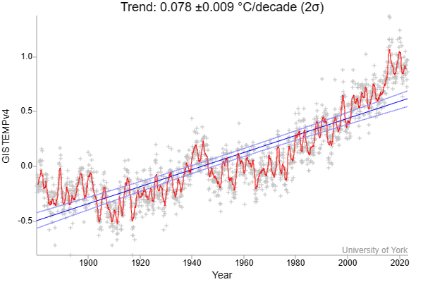
Questions| model | results| discussion
Can an energy balance model answer the questions?
The objectives of the experiment is to answer:
What if the ice block expedition 1959 happens in 2020 and 2021 again?
Are we going to have more or less melt loss?
If there is more melting loss, can we blame it on global warming?
What if they don’t used glass wool?
Did Radio Luxembourg underestimate the insulation materials or the ice itself?
Fig 1. Global temperature time series
Data source: GISTEMPv4
Notes:
My question about the expedtition are:
What if the ice block expedition 1959 happens in 2020 and 2021? Are we going to have more or less melt loss?
As you can see, right side, the global temperature time-seires shows that today there is almost 1 Celsius degree warming than 1959.
What if they didn’t used glass wool?
The glass wool is a relatively new materials at the time of the original expedition, having been widely used only after World War II. Probably just because radio Luxembourg didn’t know much about glass wool so that they made a mistake.

Slide 4
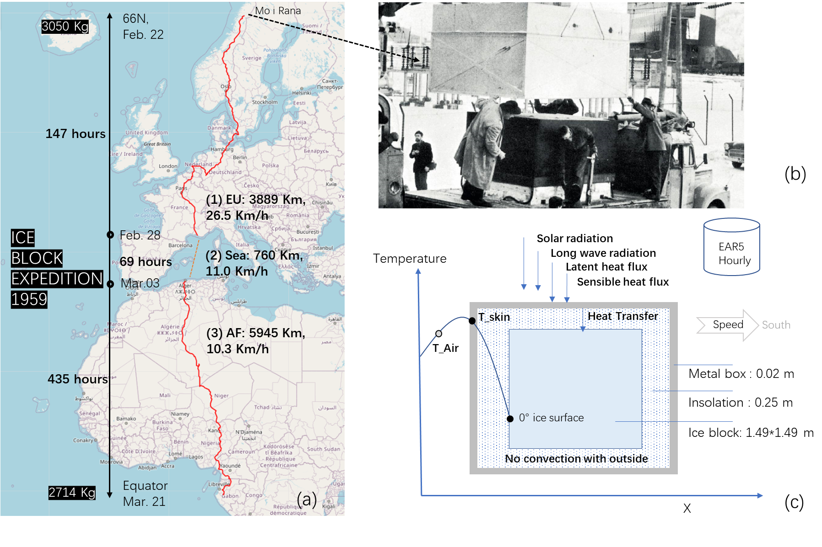
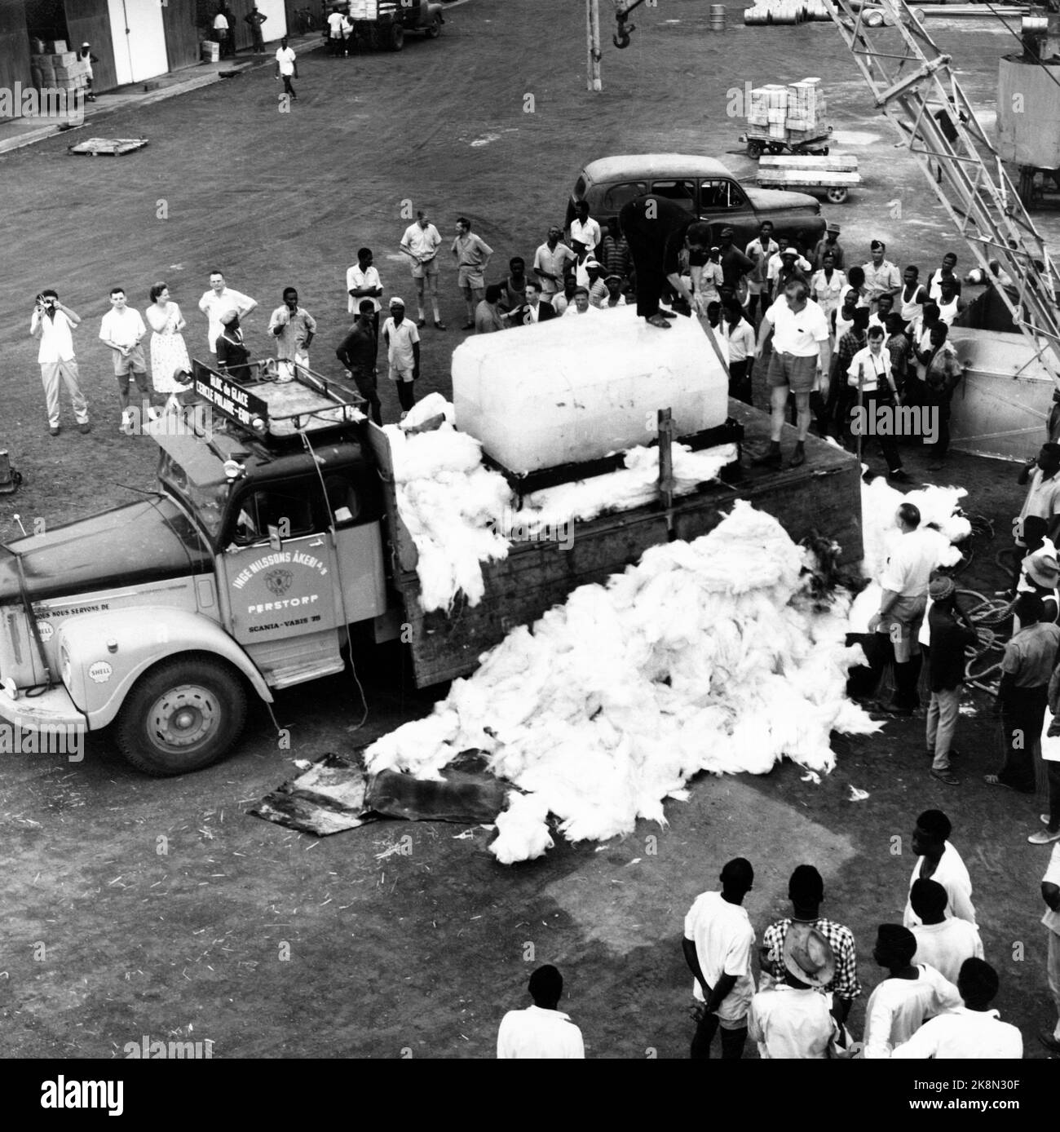
Models | results| discussion
Energy balance model and heat diffusion model
Fig 2. From historical event to models
Notes:
To figure it out, I designed an experiment, using a 1D energy balance model and 2D heat transfer model to simulate the ice melting.
- The study object are set up in three layers: metal box, insulation and ice block.
Energy is added or removed from the top of the box and follows the energy balance equation
The air temperature and other forcing data are from ERA5 Land hourly reanalysis database.
As there is ice inside the box, so we assume the temperature of ice surface is zero degree Celsius.

Slide 5
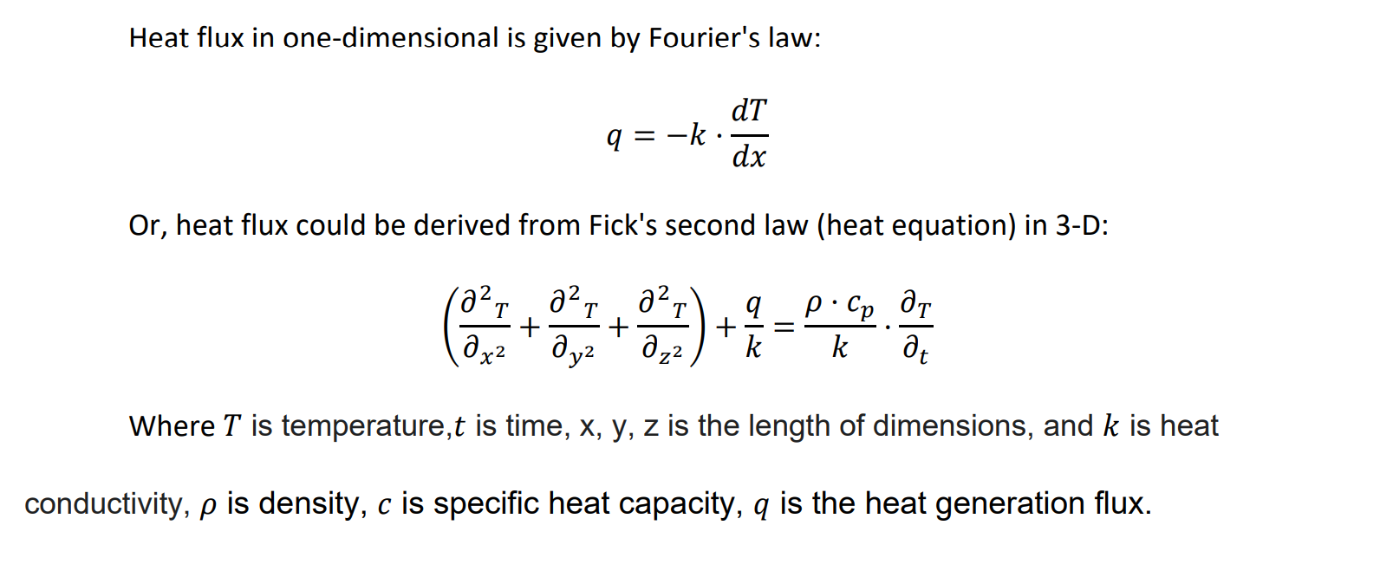
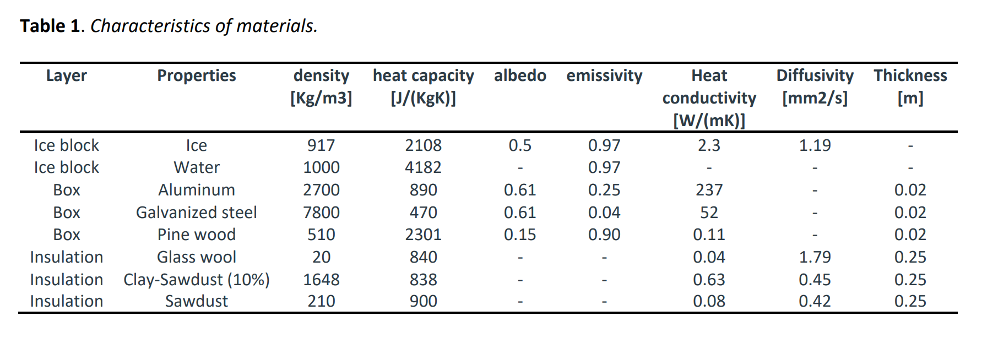
Models | results| discussion
Physics basis and materials
Notes:
I think its no need to explain physic basis for your guys.
For the heat transfer inside the ice block, I used a heat diffusion model in 2D to simulate how the ice block gets warming up.

Slide 6
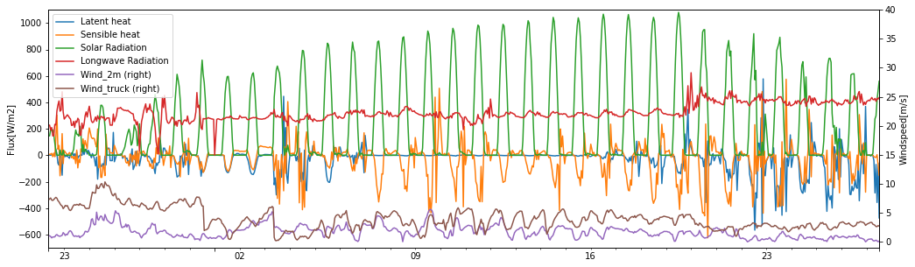
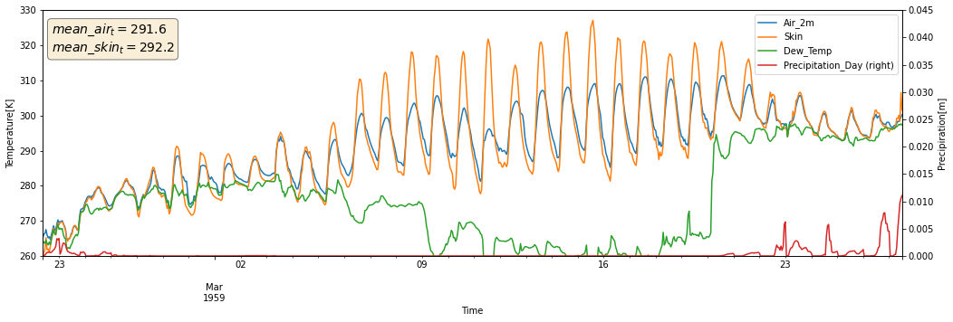
Results | discussion
Forcing data and surface temperature (1959)
Fig 3. Forcing data from ERA5 Land (1959)
Notes:
First of all, lets look at the forcing data of the trip. When they left European and entered the Sahara, the solar riadation incersed from 200 to 900 wats per square meter. Also significant contributions were from the longwave radiation.
Because of the solar radiation, in the day time the skin temperature is over air temperature, so that we can notice the negative sensible heat in orange curve.
Most of time, the skin temperature is over dew temperature, which means the big potential evaporation, if there is water available, the latent heat can help surface cool down, however there is no percipitation.

Slide 7
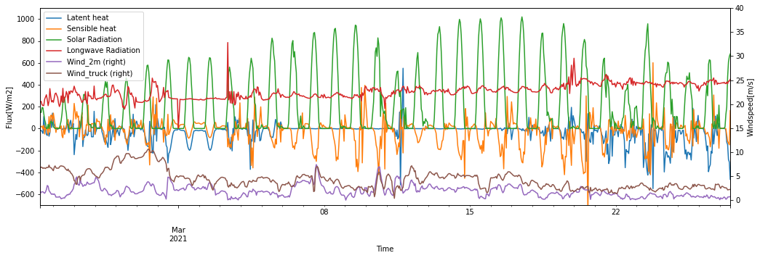
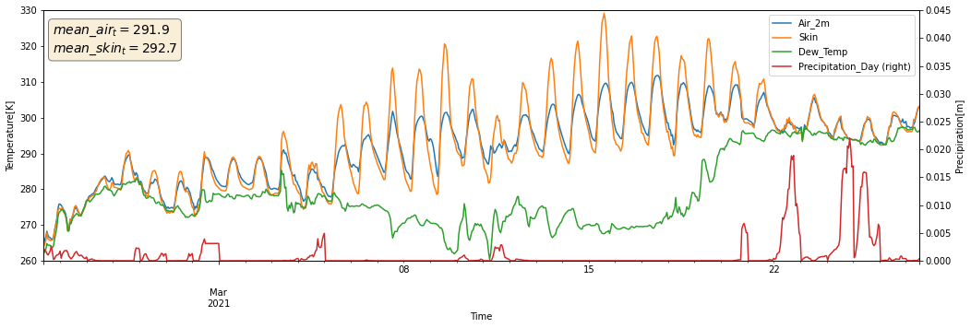
Results | discussion
Forcing data and surface temperature (2021)
Air temperature 0.3 C higher
Heavey wind in 2021.
Increase humidity and less solar radiation.
Skin temperature 0.5 C higher
Fig 4. Forcing data from ERA5 Land (2021)
Notes:
The air temperature of 2021 is 0.3 K higher than 1959, the relative windspeed of 2021 (4.3 m/s) is heavier than 1959 (3.9 m/s). There was an unusual rainy day in Sahara on 12th Mar. 2021, which increased humidity (or dew temperature) and reduced the solar radiation on that day. The skin temperature is 0.5 C than 1959.
It looks like if the expedition happen in 2021, at least the surface temperature of the container is going to be warming than 1959 if it behave like the soil skin.

Slide 8
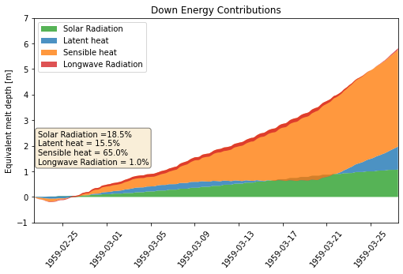
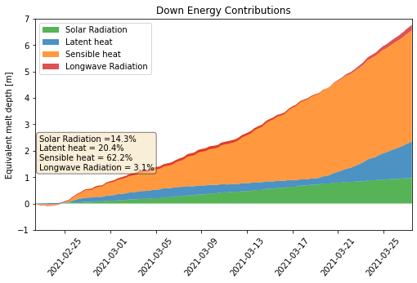
Results | discussion
1959 < 2021 : if there is bare ice
5.59 m
6.50 m
Fig 5. Bare Ice Senarioes (1959 vs 2021)
Understanding from comparison:
This is the bare surface. The ice surface does not behave like a soil, becasue its always 0 celcius degree and water is alway available.
Sensible heat flux donimates (air temperature and wind speed)
Notes:
Let see if the ice cubic does not cover by anything, just bare ice, how much it is going to melt.
Plase be in mind. The ice surface does not behave like a soil, becasue its always 0 celcius degree and water is always available!
Even if we know there is less solar radiation in 2021, the simulations show that 5.59 m of ice melted in the scenario of 1959, and 6.50 m in 2021, because of sensible heat and latent heat dominate for bare ice surface, and 2021 has higher air temperature and high wind speed, so that it melts more.

Slide 9
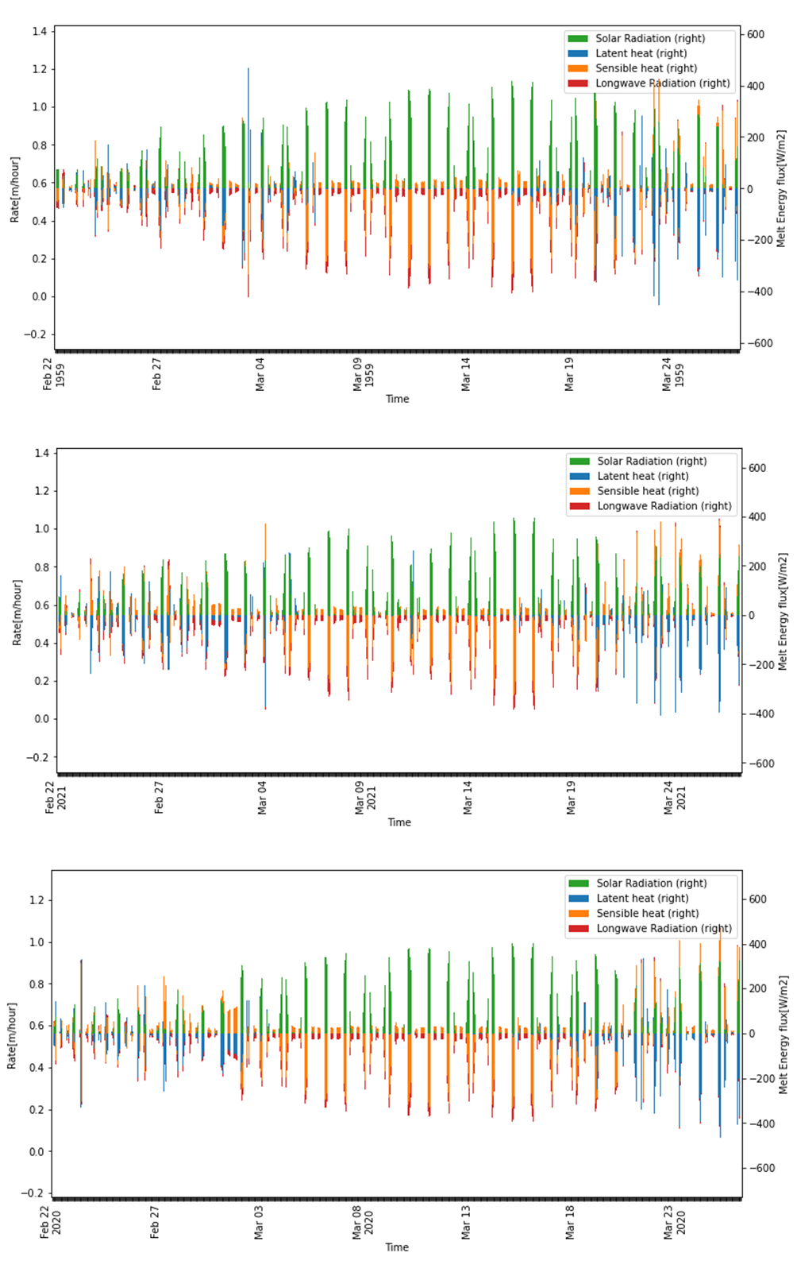
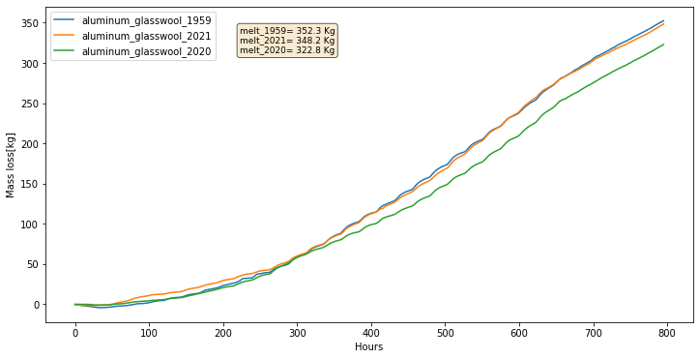
Results | discussion
2020 < 2021 < 1959 : if there is aluminum container and glass wool
1959
Algiers
Average loss in the Sahara
2021
Fig 6. Nomal Senarioes (1959 vs 2020 vs 2021)
2020
Notes:
But things are different if there is cover.
The simulation shows that, the 1959 has highest melting rate. Becasue once there is cover upon the ice, the energy schemes are totally different. the cover does not have phase change. The longwave radiation and sensible heat actually are going to be the cooling component, not the melt component, if it is warmer than air temperature, or If water is available, the evaporation would take heat away.

Slide 10
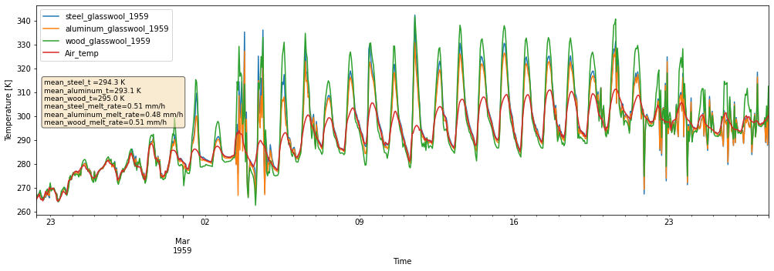
Results | discussion
Wooden < Steel < Aluminum: which cover is the coolest
Fig 7. The surface temperature of container
Notes:
In terms of different materials of the cover, I would reccomend the aluminum container.
Aluminum is a outstanding materials becasue it has lowest temperature gradient with air temperature.
First it has relative high reflectivity (0.61), so it does not absorb as much as solar radiation like woden box, but also it has high emisivity so it can make it self cool by longwave radiation.

Slide 11
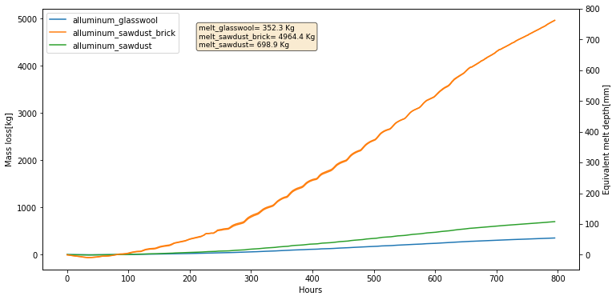
Results | discussion
Saw dust : the alternative to glass wool
Fig 8. The mass loss of different insulation materials
Notes:
When the Glasswool is good common. It can achieve 50% of performance of glass wool, which means just double the thickness of insulation layer, we can get insulation as good as Glasswool.

Slide 12
Results | discussion
Does the core of ice block still below 0 degree Celsius ?
The truth of the cold content:
Fusion heat of ice = 333.55 J/g
Fig 9. The heat distribution of the ice block
Notes:
On internet some coments said, the ice core still below 0 Celsius degree, which is not true.
The energy balance model does only works on layer surface. So, I used a heat diffusion equation simulate the heat transfer in 2D scheme, it shows that t the warming up of the ice core from -6° to 0° takes approximately 175 hours. For the first 1 cm layer of ice, it takes less 100 hours to reach 0°, but melts away until by 400 hours. Why, because the Fusion heat of ice is 333 J per gram, the phase change from 0 degree ice to 0 degree water takes a lot of energy, way bigger than make it warming up.

Slide 13
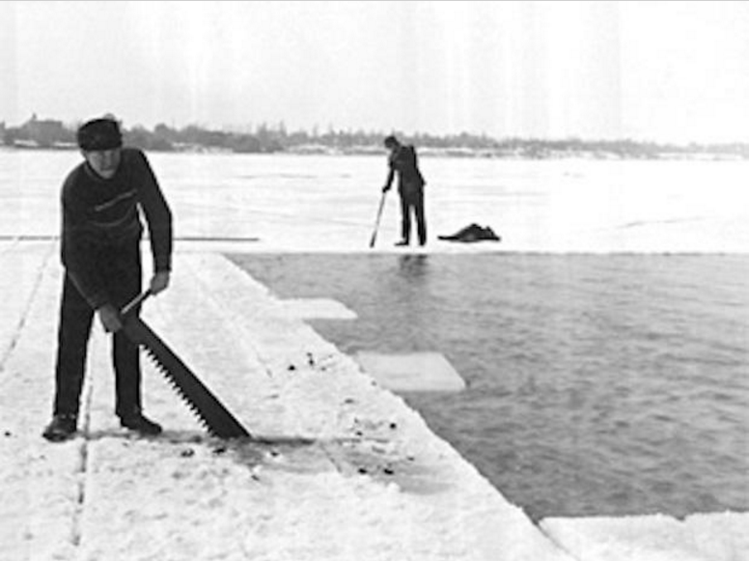
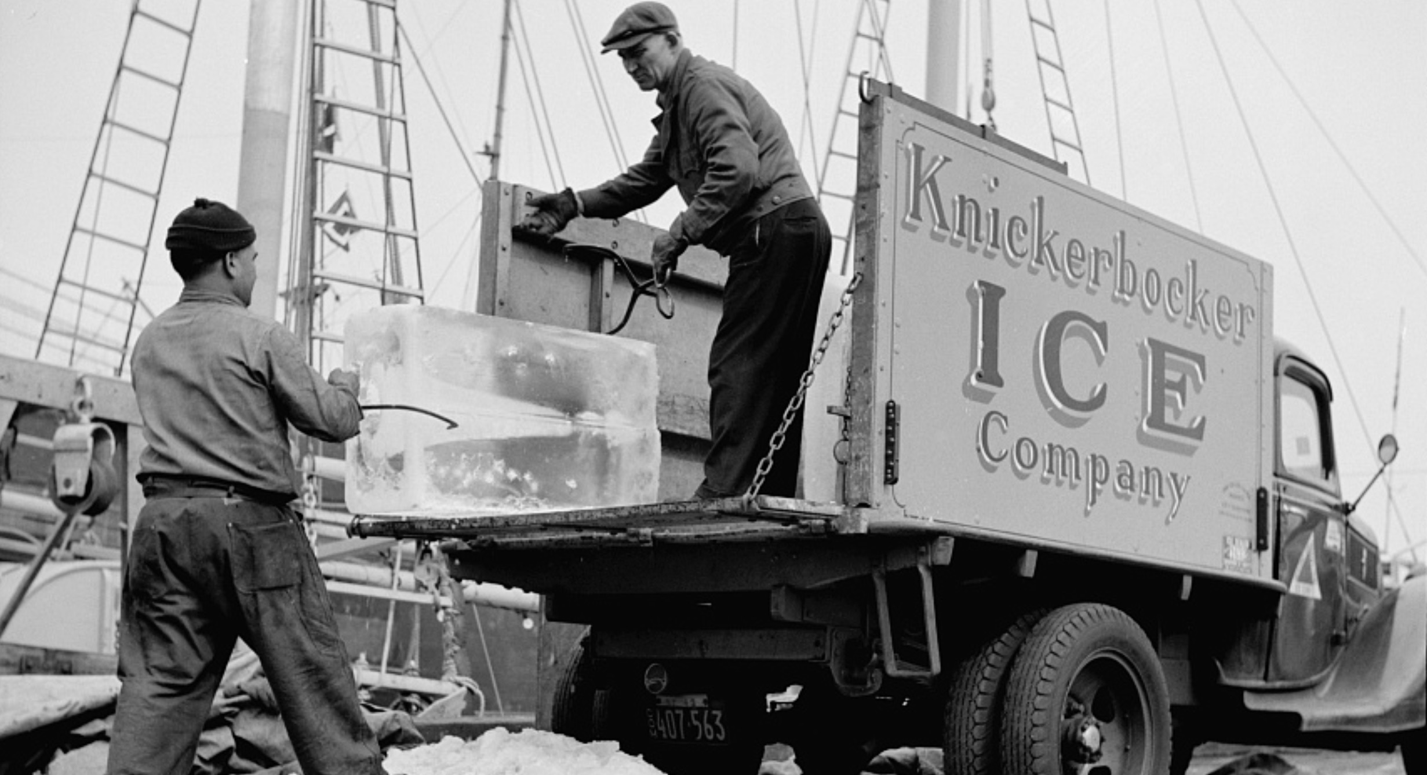
Discussion
Not just the ice block expedition…
While we set a baseline using the 1959 ice block expedition. The melt loss of transporting ice is not projected to be greater than 1959 if we do another expedition in 2021. Additionally, the simulations do not support attributing the concern to global warming because the ice is covered.
Not just the ice block expedition…
In the 19th-century, A million tons of ice was shipped from Norway each year during the golden age of ice trade. As the primary concerns of the business is melting lost, so we can call it ‘melting markets’.
By this experiment, this business has a solid physical basis.
Notes:
It is time to answer the questions, if we do another expedition in 2021, The melt loss of transporting ice is not projected to be greater than 1959. Additionally, the simulations do not support attributing the concern to global warming because the ice is covered.
A million tons of ice was shipped from Norway each year during the golden age of ice trade to England, India, South America, China and Australia. The business started at 1806, flourished in the end of 19th-century and was replaced by plant ice until World War I.
Only economic history literature have discussed it. A lot of people are surpised how durable of the ice can be transport thousands kilometers, But from this experiment, we see this business has a solid physical basis, no need the glass wool, the saw dust can do a good job.

